Slide 1
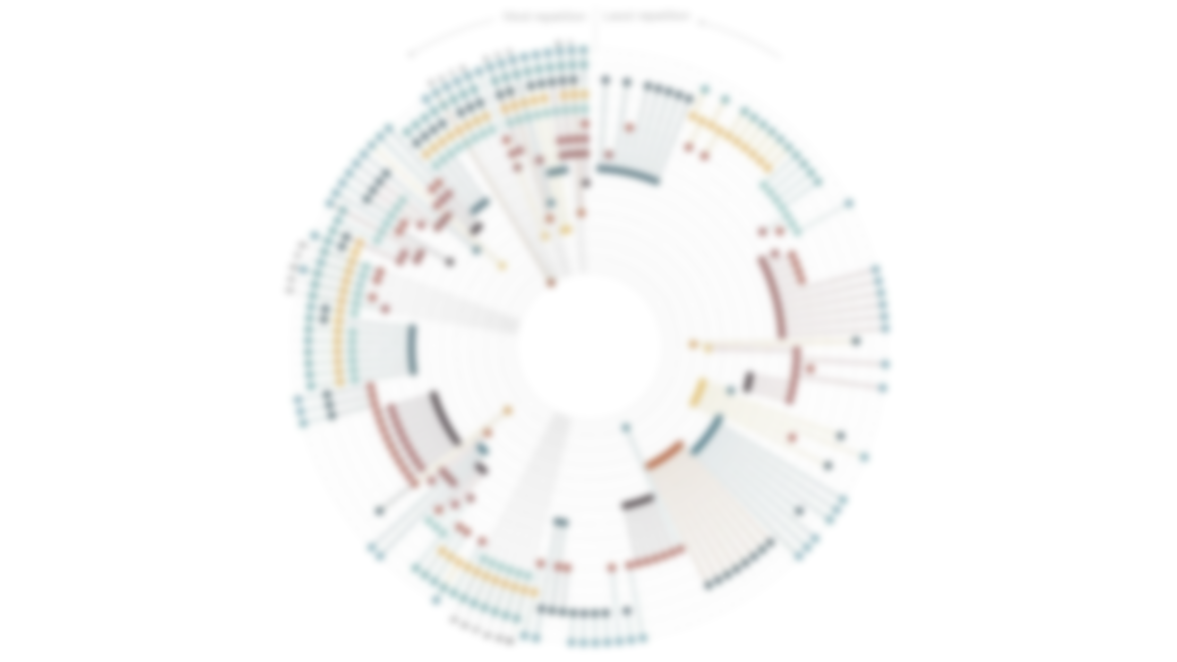
Elemental Psychopathology:
Distilling Constituent Symptoms and Patterns of Repetition
in The Diagnostic Criteria of The DSM-5

Slide 2
Introduction
Method
Result
Discussion

Slide 3
Note
DSM - 5
A diagnostic system includes multiple diagnostic categories, each of which contains multiple diagnostic criteria. If a person meets most of the diagnostic criteria in a particular diagnostic category, they will be diagnosed with a certain disease.
Diagnostic System
Diagnostic Category 1
Diagnostic Criteria a
Diagnostic Criteria b
Diagnostic Criteria c
…
Diagnostic Category 2
Diagnostic Criteria a
Diagnostic Criteria b
Diagnostic Criteria c
…
Notes:
Diagnostic system: A standardized method used to classify and describe various health problems, so that doctors and other healthcare professionals can share information and communicate. For example, DSM-5 and ICD-11 are two common diagnostic systems.
Diagnostic category: A classification in a diagnostic system used to describe common features and symptoms of a particular health problem. For example, depression, generalized anxiety disorder, and schizophrenia in DSM-5 are different diagnostic categories.
Diagnostic criteria: A set of criteria that must be met by a group of symptoms to determine a specific diagnosis.

Slide 4
Note
DSM - 5
In a diagnostic system, each diagnostic category usually has a set of symptom descriptions associated with it to help doctors or other healthcare professionals make a diagnosis.
Diagnostic Category
Core
Symptoms
Symptom a
Symptom b
Symptom c
Symptom d
Symptom e
Symptom f
Symptom g
Symptom h
Symptom i
Symptom j
Constituent
Symptoms
Notes:
Symptoms: Physical or mental discomfort or abnormal expression that patients experience, such as headache, nausea, insomnia, low mood, etc. These symptoms are the basis for judging and diagnosing health problems.
Constituent symptoms: Individual symptoms that make up a diagnosis or diagnostic criteria.
Core symptoms: The necessary basic symptoms in a diagnosis.

Slide 5
Introduction

Slide 6
Introduction
DSM - 5
Due to the heterogeneity within diagnostic categories and symptom overlap across diagnostic categories, traditional mental disorder diagnostic systems (e.g., DSM) have limitations.
Isolating a single diagnostic category:
Restricts our understanding of the fundamental causes of symptoms (Bentall et al., 2012; Fried and Nesse, 2015; Parker, 2005)
Obscures commonalities between symptoms (Barlow, 2014)
For example, there is considerable overlap in symptoms between severe depression and generalized anxiety disorder, making it possible for a person to meet the criteria for both diagnoses.
Therefore, by examining patterns of symptom overlap, researchers can identify:
Common symptoms of multiple diseases
Symptoms unique to a specific disease
This helps improve the accuracy of diagnostic classification and can lead to more effective treatments targeted at specific symptoms or groups of symptoms.
Notes:
Bentall RP, Wickham S, Shevlin M, Varese F. Do specific early-life adversities lead to specific symptoms of psychosis? A study from the 2007 the adult psychiatric morbidity survey. Schizophrenia Bulletin 2012; 38: 734-740. doi: 10.1093/schbul/sbs049
Fried EI, Nesse RM. Depression sum-scores don't add up: Why analyzing specific depression symptoms is essential. BMC Medicine. 2015; 13: 72-72. doi: 10.1186/s12916015-0325-4
Parker G. Beyond major depression. Psychological Medicine. 2005; 35: 467-474. doi: 10.1017/S0033291704004210
Barlow DH, Sauer-Zavala S, Carl JR, Bullis JR, Ellard KK. The nature, diagnosis, and treatment of neuroticism: Back to the future. Clinical Psychological Science. 2014; 2: 344365. doi: 10.1177/216770261350553

Slide 7
Introduction
DSM - 5
Similar research has been conducted in the past, examining patterns of symptom overlap
Borsboom et al.(2011) generated a symptom-level overlap network in DSM-IV-TR，
Tio et al.(2016) used the same method to examine symptom-level overlap in ICD-10
Forbes (2023) examined whether symptoms in DSM-5 are only due to comorbidity or correlation between diseases, or whether they do indeed have distinctive manifestations in certain diseases.
Notes:
Borsboom D, Cramer AOJ, Schmittmann VD, Epskamp S, Waldorp LJ. The small world of psychopathology. PloS One. 2011; 6. doi: 10.1371/journal.pone.0027407
Tio P, Epskamp S, Noordhof A and Borsboom D. Mapping the manuals of madness: Comparing the ICD-10 and DSM-IV-TR using a network approach. International Journal of Methods In Psychiatric Research. 2016; 25: 267-276. doi: 10.1002/mpr.1503
Forbes MK. Implications of the symptom-level overlap among DSM diagnoses for dimensions of psychopathology. Journal of Emotion and Psychopathology. 2023; 1(1): 104-112. doi: 10.55913/joep.v1i1.6

Slide 8
Introduction
DSM - 5
This study uses a descriptive approach to address several questions:
How many different symptoms make up the hundreds of diagnostic criteria defined in DSM-5?
To what extent do these symptoms overlap within and across diagnostic categories?
What are the prominent patterns of symptom overlap between different diagnostic categories?
Are there any diagnostic categories that are more likely to exhibit symptom overlap than others?
Which symptoms are most repeated across different diagnostic categories?

Slide 9
Method

Slide 10
Method
DSM - 5
The DSM-5 specificity criteria for all diagnoses in Sections I-IX were simplified to their core symptoms using the rules below based on Borsboom et al. (2011) and Tio et al. (2016):
Only symptoms related to adult psychopathology were included.
Criteria containing "or" were split into separate symptoms.
The cause and consequence of symptoms were separated.
Descriptive information related to the timing, duration, frequency, and severity of symptoms was excluded.
For each disorder listed in each chapter, only related special symptoms (additional symptoms) were listed once to avoid duplication in multiple disorders.
If a special symptom specified a new symptom or described a new syndrome, it was considered an independent diagnostic criterion rather than merged with the diagnostic criteria of the related disorder.
If only the cause, background, comorbid symptom, subset/mixed symptom, etc. of the disorder was specified, it was not considered an independent diagnostic criterion.
Notes:
Borsboom D, Cramer AOJ, Schmittmann VD, Epskamp S, Waldorp LJ. The small world of psychopathology. PloS One. 2011; 6. doi: 10.1371/journal.pone.0027407
Tio P, Epskamp S, Noordhof A and Borsboom D. Mapping the manuals of madness: Comparing the ICD-10 and DSM-IV-TR using a network approach. International Journal of Methods In Psychiatric Research. 2016; 25: 267-276. doi: 10.1002/mpr.1503

Slide 11
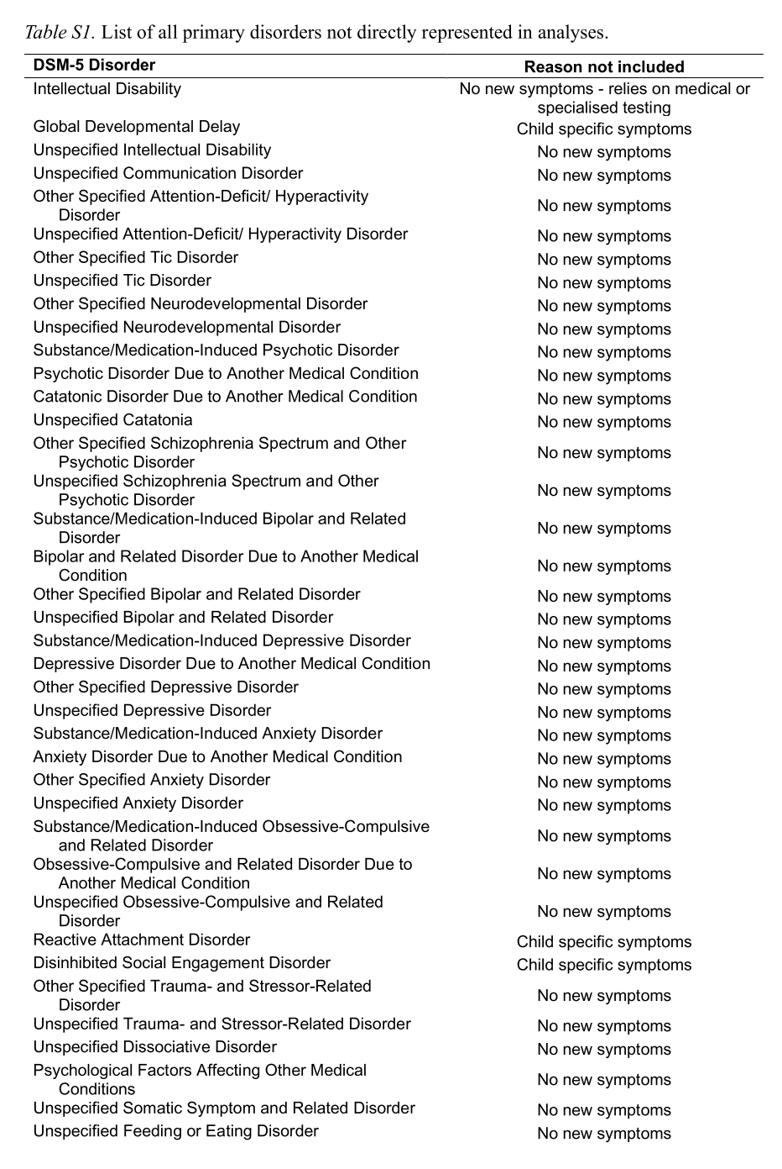
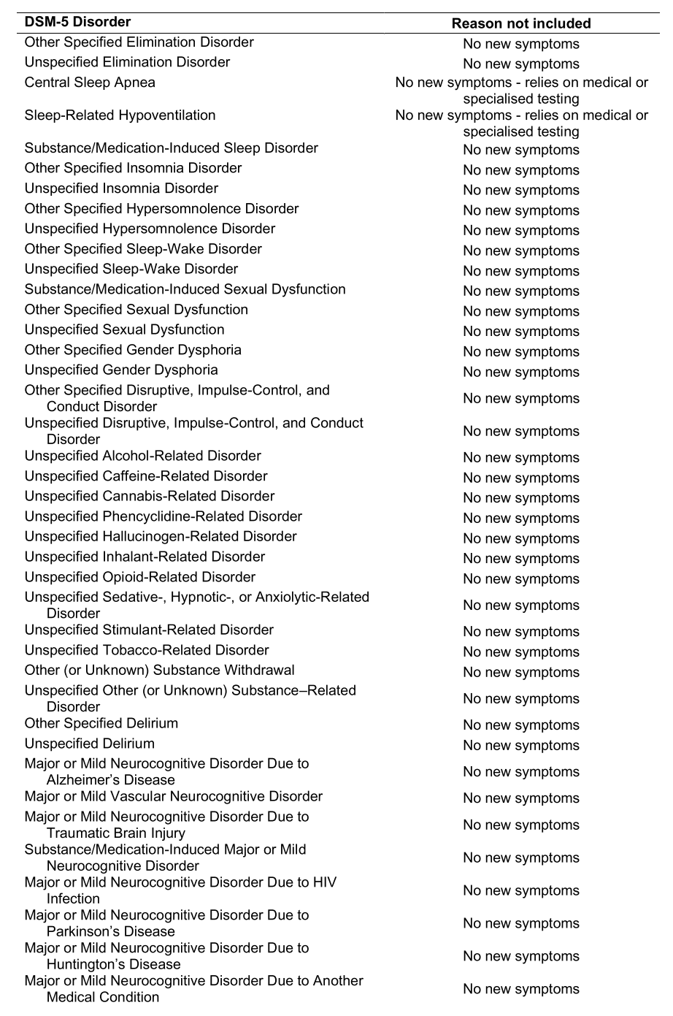
Method
DSM - 5
The diseases that do not meet the above rules will not be included in the analysis, totaling 85, of which 82 did not list any special symptoms (additional symptoms).

Slide 12
Method
DSM - 5
There is ambiguity or uncertainty that exists in defining certain diagnostic criteria. This is because some diagnostic criteria describe symptoms that may be broad or abstract, leading to a lack of specific details about the symptoms.
For example, for the disease of neurocognitive disorders, one symptom is "significant cognitive decline," but there is no specific definition for what constitutes "significant" cognitive decline.
Therefore, in this project, we need to determine the specific content of a diagnostic criterion by referencing other related symptoms and its specific diagnostic criteria to ensure consistency in the analysis.
Overall, this study will use Qualitative Content Coding and Natural Language Processing (NLP) to test for content overlap among core symptoms.

Slide 13
Method
DSM - 5
The core symptoms were examined for content overlap using Qualitative Content Coding.
The same symptoms were identified and labeled as the same.
Four members performed the following steps on these concepts:
Firstly, symptoms were assigned to emotional, behavioral, cognitive, or physical symptom categories.
Then, symptoms were further divided into subcategories.
For example, emotional symptoms were coded as low mood, high mood, mood swings, anxious mood, angry mood, and restricted affect.
Finally, symptoms were coded for content overlap within each subcategory, based on a heuristic rule, to determine whether multiple symptoms represented the same subjective experience.
For instance, depressed mood and low mood were considered the same subjective experience.
The entire process was repeated more than 90 times.

Slide 14
Method
DSM - 5
Using Natural Language Processing (NLP) to identify any possible semantic matches that may have been missed.
A computational model was established to evaluate the relative distance of two symptoms in semantic similarity and determine when they have the same meaning.
After filtering out symptom pairs that were already considered to be the same, the pre-trained model of the model was used to score the remaining possible symptom pairs.
A five-fold cross-validation framework was used to evaluate the performance of the model. 。
The dataset was divided into five equal parts, with four used as the training set and one as the validation set for five model training and validation cycles to evaluate the model's performance.
Two researchers manually checked the top 1,000 pairs of symptoms with the highest semantic similarity scores for other matching items and ultimately identified 26 new matching pairs of symptoms, for a total of 3,096 matched pairs of symptoms.。

Slide 15
Result

Slide 16
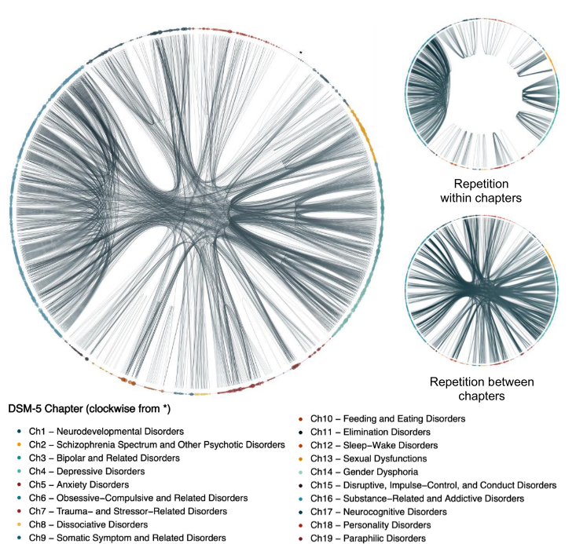
Result
DSM - 5
Among 628 different symptoms,
397 (63.2%) were single symptoms,
231 (36.8%) were non-single symptoms.
Non-single symptoms appeared a total of 1022 times, accounting for 72.0% of all symptoms listed in the diagnostic criteria.

Slide 17
Result
DSM - 5
Content overlap for non-single symptoms
163 (70.6%) recurred in the same chapter
155 (67.1%) were repeated across multiple chapters
87 (37.7%) were repeated both within and between chapters

Slide 18
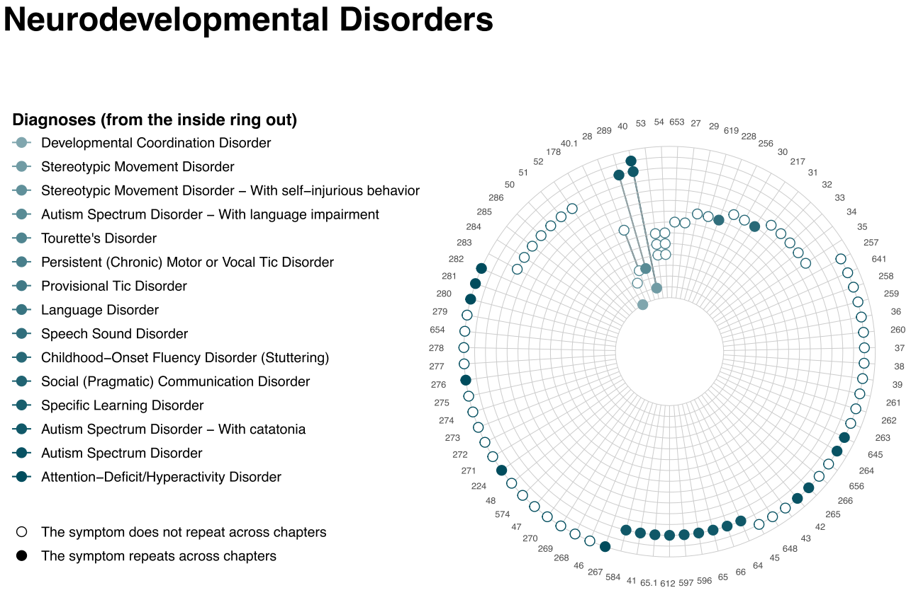
Result
DSM - 5
140 diagnostic criteria (69.3%) had at least one symptom repeated in another diagnostic criteria
Notes:
每一同心圆代表一个诊断标准，不同的同心圆用不同深浅的颜色标注
整个图代表一类疾病的诊断标准
每一条线代表一个症状
如果一个症状在多个诊断标准上出现，那么当一条线穿越多个同心圆时，交点处就会被标为实心
如果一个症状只在一个诊断标准上出现，那么当这条线穿越多个同心圆时，只有一个交点会出现一个圆圈，并且是空心圆。

Slide 19
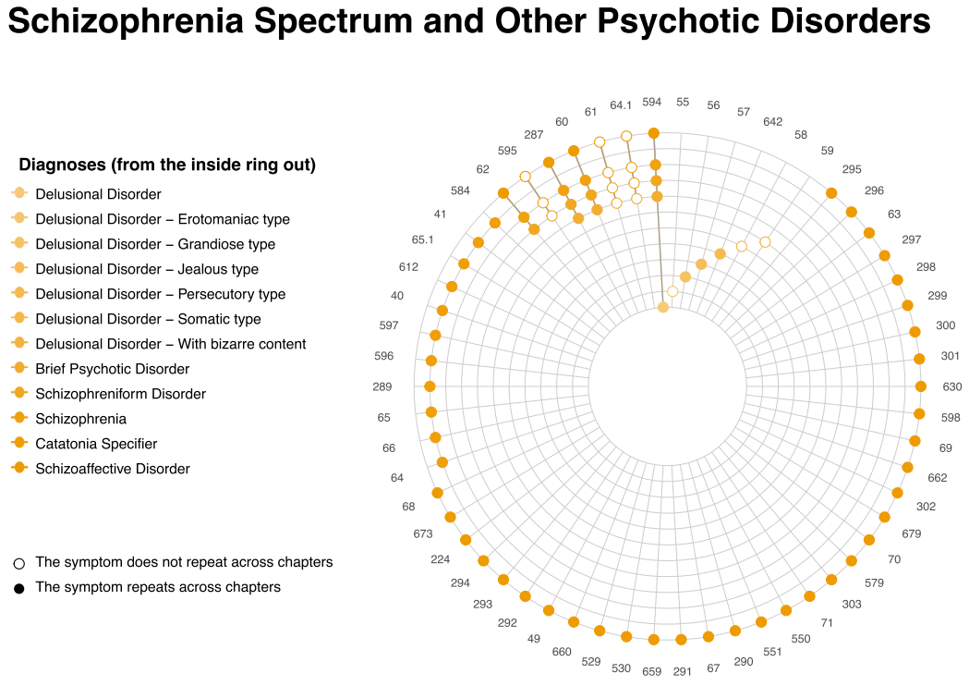
Result
DSM - 5
118 diagnostic criteria (58.4%) were repeated in another chapter
Notes:
每一同心圆代表一个诊断标准，不同的同心圆用不同深浅的颜色标注
整个图代表一类疾病的诊断标准
每一条线代表一个症状
如果一个症状在多个诊断标准上出现，那么当一条线穿越多个同心圆时，交点处就会被标为实心
如果一个症状只在一个诊断标准上出现，那么当这条线穿越多个同心圆时，只有一个交点会出现一个圆圈，并且是空心圆。

Slide 20
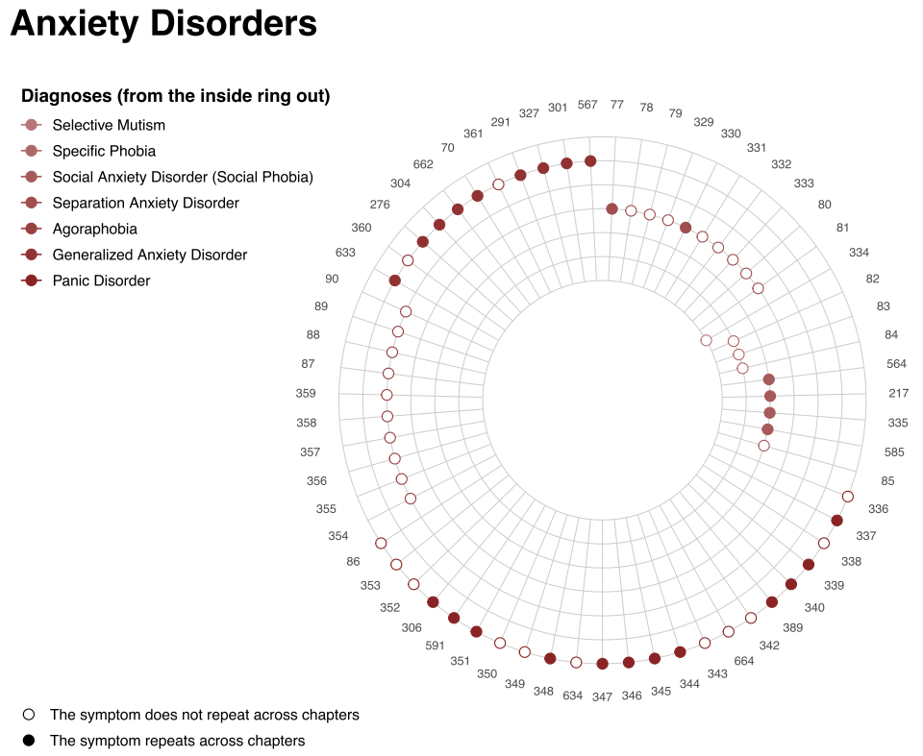
Result
DSM - 5
Each symptom of 75 diagnostic criteria (37.1%) was repeated in at least one other diagnostic criteria
Notes:
每一同心圆代表一个诊断标准，不同的同心圆用不同深浅的颜色标注
整个图代表一类疾病的诊断标准
每一条线代表一个症状
如果一个症状在多个诊断标准上出现，那么当一条线穿越多个同心圆时，交点处就会被标为实心
如果一个症状只在一个诊断标准上出现，那么当这条线穿越多个同心圆时，只有一个交点会出现一个圆圈，并且是空心圆。

Slide 21
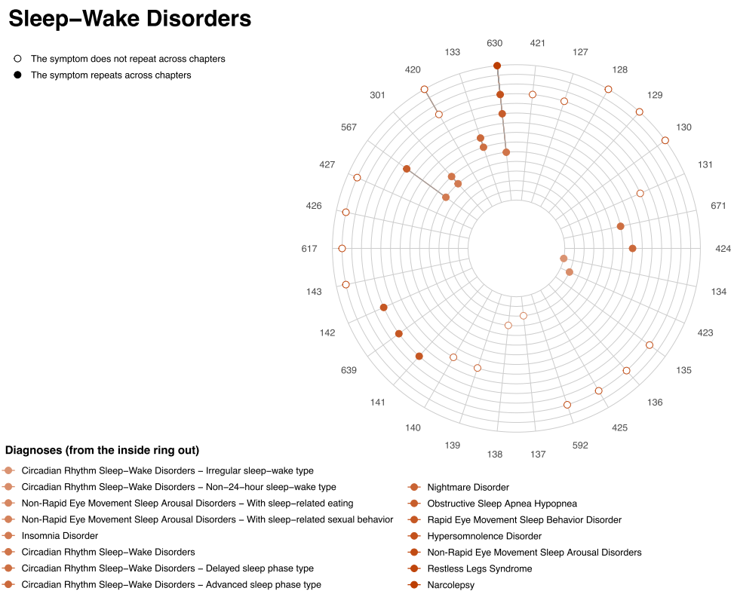
Result
DSM - 5
Each symptom of 47 diagnostic criteria (23.3%) was repeated in other chapters
Notes:
每一同心圆代表一个诊断标准，不同的同心圆用不同深浅的颜色标注
整个图代表一类疾病的诊断标准
每一条线代表一个症状
如果一个症状在多个诊断标准上出现，那么当一条线穿越多个同心圆时，交点处就会被标为实心
如果一个症状只在一个诊断标准上出现，那么当这条线穿越多个同心圆时，只有一个交点会出现一个圆圈，并且是空心圆。

Slide 22
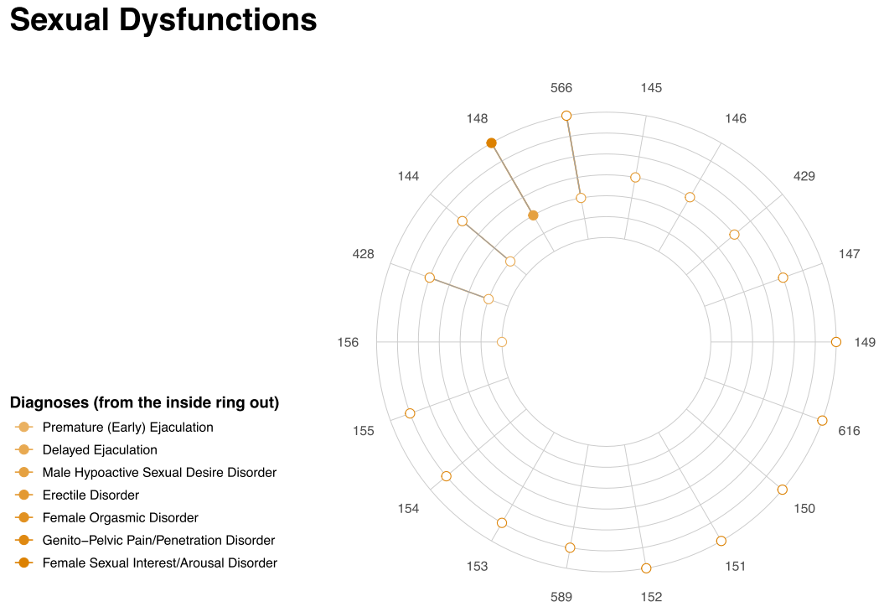
Result
DSM - 5
62 diagnostic criteria (30.7%) had no symptom overlap, and 35 diagnostic criteria included only a single symptom
Notes:
每一同心圆代表一个诊断标准，不同的同心圆用不同深浅的颜色标注
整个图代表一类疾病的诊断标准
每一条线代表一个症状
如果一个症状在多个诊断标准上出现，那么当一条线穿越多个同心圆时，交点处就会被标为实心
如果一个症状只在一个诊断标准上出现，那么当这条线穿越多个同心圆时，只有一个交点会出现一个圆圈，并且是空心圆。

Slide 23
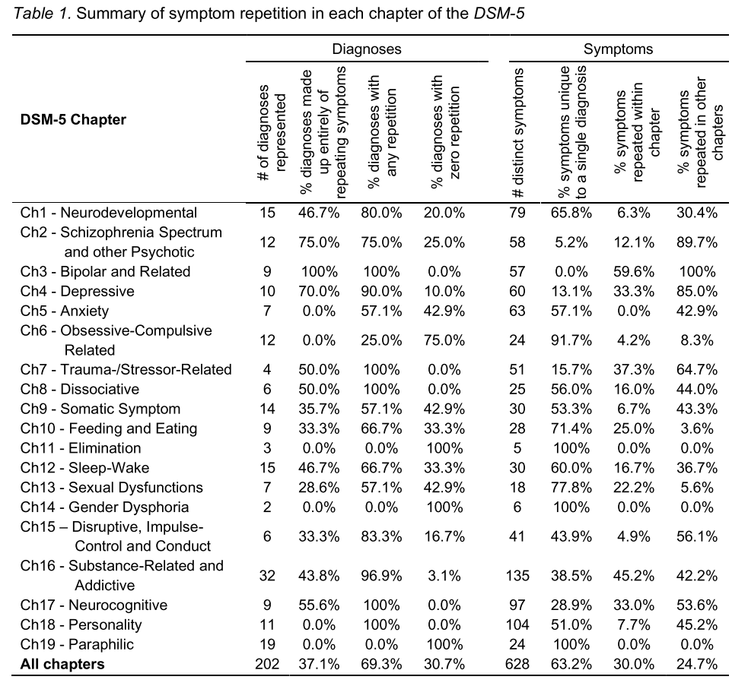
Result
DSM - 5
Some domains are more prone to duplication of symptoms than others

Slide 24
Result
DSM - 5
Some symptoms mentioned in certain sections do not appear in any other diagnostic criteria
e.g., Elimination Disorders, Gender Dysphoria, or Paraphilic Disorders

Slide 25
Result
DSM - 5
while in other sections, at least one symptom mentioned appears in other diagnostic criteria.
e.g.，Bipolar and Related Disorders, Trauma- and Stressor Related Disorders, Dissociative Disorders, Neurocognitive Disorders, and Personality Disorders

Slide 26
Result
DSM - 5
Repeatability of symptoms varies between diseases
Symptoms of some diseases are highly repetitive, e.g., Bipolar and Related Disorders、Schizophrenia Spectrum and Other Psychotic Disorders、Depressive Disorders、Trauma- and Stressor-Related Disorders、Neurocognitive Disorders和Disruptive, Impulse Control, and Conduct Disorders
Symptoms of some diseases are less reproducible, e.g., Elimination Disorders、Gender Dysphoria、Paraphilic Disorders、Feeding and Eating Disorders、Sexual Dysfunctions和Obsessive-Compulsive Related Disorders

Slide 27
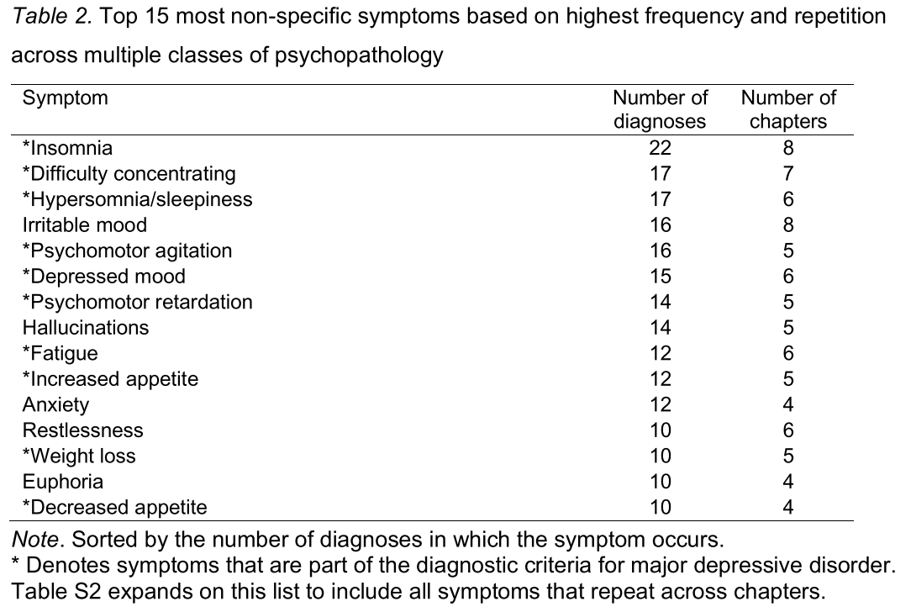
Result
DSM - 5
Most Repeated Symptom
Notes:
本文列出了哪些症状在诊断标准之间容易被重复
比如失眠，难以集中注意力，嗜睡等

Slide 28
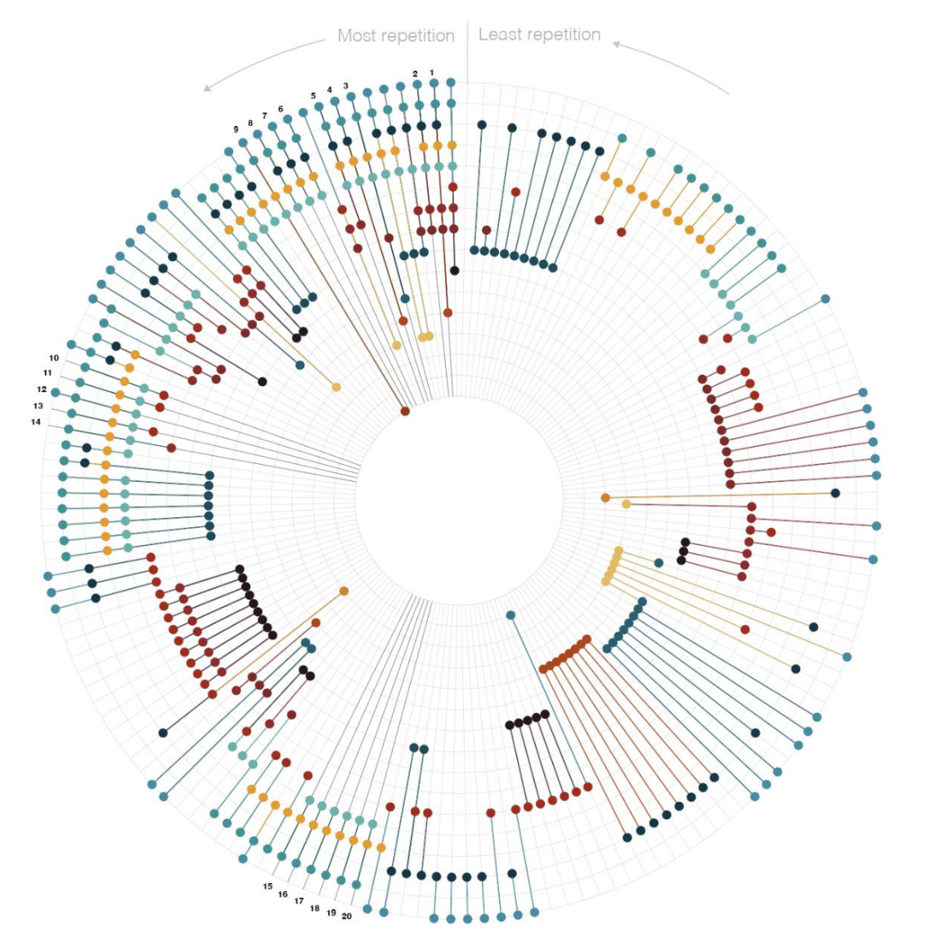
Result
DSM - 5
Notes:
逆时针方向是被重复次数最多的症状，顺时针方向是被重复次数最少的症状
每一条垂直于圆的线都代表一个症状，每一圈同心圆代表一个章节
如果该症状在该章节出现，则会画出一个实心圆（每个章节的圆颜色不同）

Slide 29
Discussion

Slide 30
Discussion
DSM - 5
Symptom repetition may not be as common as initially thought
Although 231 repeated symptoms spanned 140 diagnoses and 16 chapters, almost two-thirds of unique symptoms were associated with only one diagnostic criterion, and 30% of diagnostic criteria had no repetition.。

Slide 31
Discussion
DSM - 5
In some disease classifications, the repetition of symptoms appears to be intentional.
Disorders such as bipolar and related disorders, major depressive disorder, and others include both elevated and depressed moods;
Acute stress disorder and posttraumatic stress disorder have significant symptom overlap;
Core symptoms of various substance use disorders are also similar;
Neurocognitive disorders include deficits in complex attention, executive function, learning and memory, language, perceptual-motor skills, and social cognition.
The repetitive nature of depressive symptoms differs from other disorders.
Although depression and anxiety disorders share similarities, there are no overlapping symptoms.

Slide 32
Discussion
DSM - 5
Some diseases have significant symptom overlap between different chapters, but little symptom overlap between different disorders within the same chapter.。
For example, symptoms of neurodevelopmental disorders, anxiety disorders, somatic symptom and related disorders, personality disorders, as well as impulse control and conduct disorders have considerable overlap between different chapters (30% to 56%), but relatively little overlap between different disorders within the same chapter (5% to 8%).。
This may be because the authors of each chapter strive to ensure clear differentiation between diagnoses, but do not necessarily do so across chapters.。

Slide 33
Discussion
DSM - 5
Depression symptoms are the most frequently repeated across chapters among all symptoms.的
Depression symptoms appear in 35 diagnoses, including anxiety disorders, trauma and stress-related disorders, somatic symptom and related disorders, eating and feeding disorders, sleep-wake disorders, substance-related and addictive disorders, neurocognitive disorders, and personality disorders (Fried and Nesse, 2015; McGlinchey et al., 2006; Winter et al., 2022; Zimmerman et al., 2006a; Zimmerman et al., 2006b)
Considering depression as a single construct may not make much sense.
Notes:
Fried EI, Nesse RM. Depression is not a consistent syndrome: An investigation of unique symptom patterns in the STAR∗D study. Journal of Affective Disorders. 2015; 172: 96102. doi: 10.1016/j.jad.2014.10.010
McGlinchey JB, Zimmerman M, Young D, Chelminski I. Diagnosing major depressive disorder VIII: Are some symptoms better than others? The Journal of Nervous and Mental Disease. 2006; 194: 785-790. doi: 10.1097/01.nmd.0000240222.75201.aa
Winter NR, Leenings R, Ernsting J, Sarink K, Fisch L, Emden D, Blanke J, Goltermann J, Opel N, Barkhau C, Meinert S, Dohm K, Repple J, Mauritz M, Gruber M, Leehr EJ, Grotegerd D, Redlich R, Jansen A, Nenadic I, Noethen MM, Forstner A, Rietschel M, Gross J, Bauer J, Heindel W, Andlauer T, Eickhoff SB, Kircher T, Dannlowski U, Hahn T. Quantifying deviations of brain structure and function in major depressive disorder across neuroimaging modalities. JAMA Psychiatry. 2022; 79: 879-888. doi: 10.1001/jamapsychiatry.2022.1780
Zimmerman M, Chelminski I, McGlinchey JB, Young D. Diagnosing major depressive disorder X: Can the utility of the DSM-IV symptom criteria be improved? The Journal of Nervous and Mental Disease. 2006; 194: 893-897. doi: 10.1097/01.nmd.0000248970.50265.34
Zimmerman M, McGlinchey JB, Young D, Chelminski I. Diagnosing major depressive disorder I: A psychometric evaluation of the DSM-IV symptom criteria. The Journal of Nervous and Mental Disease. 2006; 194: 158-163. doi: 10.1097/01.nmd.0000202239.20315.16

Slide 34
Discussion
DSM - 5
The repetition of MDD symptoms across different disorders appears to be very common, perhaps because the situations described by MDD symptoms, such as sleep problems, lack of concentration, and low mood, reflect symptoms involved in many DSM-5 diagnoses.
The widespread presence of these symptoms may hinder diagnostic accuracy and may lead to other diagnosis symptoms being mistakenly attributed to MDD symptoms (Zimmerman et al., 2006; Horvath, 2022)
The overlap of symptoms between MDD and other diagnoses may result in an individual being diagnosed not only with MDD, but also with other disorders, leading to a high comorbidity rate of MDD (Zbozinek et al., 2012; Hasin et al., 2018)
Notes:
Zimmerman M, Chelminski I, McGlinchey JB, Young D. Diagnosing major depressive disorder X: Can the utility of the DSM-IV symptom criteria be improved? The Journal of Nervous and Mental Disease. 2006; 194: 893-897. doi: 10.1097/01.nmd.0000248970.50265.34
Horvath A. Shared depressive symptomatology across mental disorders: Implications for mental health assessments. Master’s Thesis. Sydney University, Camperdown; 2022.
Zbozinek TD, Rose RD, Wolitzky-Taylor KB, Sherbourne C, Sullivan G, Stein MB, RoyByrne PP, Craske MG. Diagnostic overlap of generalized anxiety disorder and major depressive disorder in a primary care sample. Depression and Anxiety. 2012; 29: 10651071. doi: 10.1002/da.22026
Hasin DS, Sarvet AL, Meyers JL, Saha TD, Ruan WJ, Stohl M, Grant BF. Epidemiology of adult DSM-5 major depressive disorder and its specifiers in the United States. JAMA Psychiatry. 2018; 75: 336-346. doi: 10.1001/jamapsychiatry.2017.4602

Slide 35
Discussion
DSM - 5
Further empirical research is needed to analyze how symptoms are formed in diseases, in order to determine whether certain symptoms appear in multiple diseases, making the distinction between these diseases blurred.
Such research could provide a better framework for biomarkers and mechanisms (Insel et al., 2010); active ingredients and specific processes in psychotherapy (Hofmann and Hayes, 2019; Wolpert et al., 2021); and the reconceptualization of the diagnosis and classification of psychopathology (Kotov et al., 2017).
Notes:
Insel T, Cuthbert B, Garvey M, Heinssen R, Pine DS, Quinn K, Sanislow C, Wang P. Research Domain Criteria (RDoC): Toward a new classification framework for research on mental disorders. The American Journal of Psychiatry. 2010; 167: 748-751. doi: 10.1176/appi.ajp.2010.09091379
Hofmann SG, Hayes SC. The future of intervention science: Process-based therapy. Clinical Psychological Science. 2019; 7: 37-50. doi: 10.1177/2167702618772296
Wolpert M, Pote I, Sebastian CL. Identifying and integrating active ingredients for mental health. The Lancet Psychiatry 2021; 8: 741-743. doi:10.1016/S2215-0366(21)00283-2
Kotov R, Krueger RF, Watson D, Achenbach TM, Althoff RR, Bagby RM, Brown TA, Carpenter WT, Caspi A, Clark LA, Eaton NR, Forbes MK, Forbush KT, Goldberg D, Hasin D, Hyman SE, Ivanova MY, Lynam DR, Markon K, Miller JD, Moffitt TE, Morey LC, Mullins-Sweatt SN, Ormel J, Patrick CJ, Regier DA, Rescorla L, Ruggero CJ, Samuel DB, Sellbom M, Simms LJ, Skodol AE, Slade T, South SC, Tackett JL, Waldman ID, Waszczuk MA, Widiger TA, Wright AGC, Zimmerman M. The Hierarchical Taxonomy of Psychopathology (HiTOP): A dimensional alternative to traditional nosologies. Journal of Abnormal Psychology. 2017; 126: 454-477. doi: 10.1037/abn0000258

Slide 36
Thanks

